Slide 1
Chapter 6 – Synthetic Biomaterials

Slide 2
Notes:
Figure 6.1: An overview of examples of biomaterials commonly used in various biomedical applications. a) Synthetic biomaterials, b) Natural biomaterials.

Slide 3
Notes:
Figure 6.2: Examples of non-covalent intermolecular interactions between two polymer chains (ionic interaction on the left and hydrogen bond on the right).

Slide 4
Notes:
Figure 6.3: Classification of Materials. Examples: alginate, polyethylenglycol, cyclodextrin alginate, and sintered Bioglass®.
From 45S5 Bioglass®-derived glass–ceramic scaffolds for bone tissue engineering, Biomaterials 27, 11, 2414-2425, Chen et al., 2006 and β-Cyclodextrin-crosslinked alginate gel for patient-controlled drug delivery systems: regulation of host–guest interactions with mechanical stimuli, Izawa et al., 2013,Journal of Materials Chemistry B 1(16): 2155-2161.

Slide 5
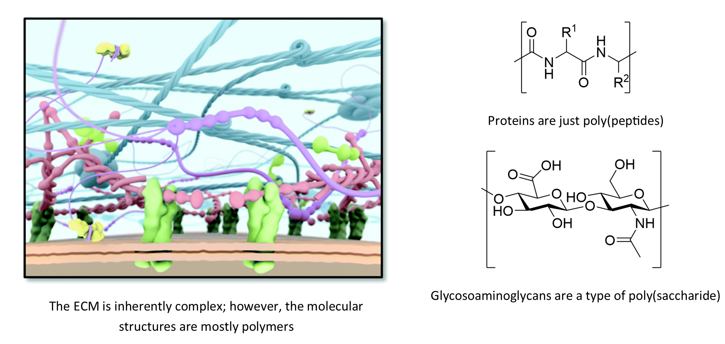
Notes:
Figure 6.4: The ECM is made up of a complex mixture of naturally occurring polymers. A major challenge in the field is to try to mimic these structures and this complexity with synthetically designed systems.
From supramolecular polymers to multi-component biomaterials, Goor et al., 2017, Chemical Society Reviews.

Slide 6
Notes:
Figure 6.5: Degradation of Synthetic biomaterials. Hydrolysis (a) and enzymatic degradation (b). Examples of rational design of degradable biomaterials: c) SEM images of electrospun PDLLA/PLGA composite mats after incubation in PBS (pH 7.4) for 4 and 12 weeks at 37 °C; and (d) hyaluronic acid modified with protease-degradable methacrylated peptide (cleavage site: dotted rectangle) and fluorophore to facilitate monitoring of degradation and in situ imaging.
Figure 6.5c from Electrospun PDLLA/PLGA composite membranes for potential application in guided tissue regeneration, Zhang et al., 2016 Materials Science and Engineering: C 58, 278-285. Figure 6.5d from Wade et al., 2015, Nature Communications 6, 6639.

Slide 7
Notes:
Figure 6.6: Designing the mechanical properties of synthetic biomaterials and, hence, the cell behavior. Podocyte cells sense and respond to hydrogel stiffness (a) representative immunofluorescence images of podocytes cultured on PAAm substrates with an elastic modulus ranging from 0.6 to 44 kPa, and (b) percentage of podocytes cover surface as function of substrate’s elastic modulus. Stiffness and stress relaxation affect renal phenotype and undesired fibrotic markers for pluripotent stem cell-derived kidney organoids: c) scheme of the oxidized alginate hydrogels with increased stiffness (similar stress relaxation) by increasing cross-linking degree, or different stress relaxation (similar stiffness) by changing the cross-linker; and (d) images of organoids encapsulated until 7+18 d in 0.1 kPa hydrogels (d,I and e,j ) showed apical enrichment of LTL+ tubules compared to organoids grown in the other hydrogels. The air–liquid interface grown organoids show a clear apical and basal orientated LTL+ staining (a.f,k,p). When comparing LTL intensity apical vs basal a significant increase expression (***=0.0002 and ****<0.0001 for slow and fast-relaxing hydrogel respectively; one-way ANOVA) was observed in the soft hydrogels. Scale bars: 50 μm.
Figure 6.6a-b from ACS Applied Materials & Interfaces, Abdallah et al., 2019, 11 (36), 32623-32632. Figure 6.6c-d from Soft, dynamic hydrogel confinement improves kidney organoid lumen morphology and reduces epithelial–mesenchymal transition in culture, Ruiter et al., 2021, bioRxiv 2021.11.10.467741.

Slide 8
Notes:
Figure 6.7: Toolbox for designing stimuli-responsive synthetic biomaterials. a) Examples of common stimuli-responsive chemical functionalities employed in synthetic biomaterials. b) A summary of common mechanisms for stimuli-responsive biomaterials.

Slide 9
Notes:
Figure 6.8: Incorporating signaling molecules in synthetic biomaterials. (a) Examples of common reactions employed to modify peptides/proteins. Here, R1 and R2 can each refer to a peptide/protein, a biomaterial, or additional functional group. (b) Schematic diagram depicting photopatterning of HANDBF/MMPx hydrogels and subsequent breast cancer cell invasion. Two-photon irradiation of NDBF uncages a reactive thiol, with the concentration of the free thiol proportional to the number of two-photon scans. The free thiol then reacts with maleimide-streptavidin (mal-streptavidin), forming immobilized streptavidin patterns. Biotinylated EGF, modified with Alexa Fluor 555 for visualization (EGF555), binds to the immobilized streptavidin to create EGF gradients. (c, d) The molecular environment of RGD attachment plays a significant role on HDF cells. c) Images of HDF cells stained with Phalloidin (green, F-actin) and DAPI (blue, nuclei) after 7 days on DN/RGD-dynamic (OA2.5 P10 DN hydrogel with RGD attached to OA network) and DN/RGD-static (OA2.5 P10 DN hydrogel with RGD attached to PEGDA network). Scale bar: 100 μm. (d) Aspect ratio were analyzed at day 1, 3, and 7 for HDFs on DN/RGD-dynamic and DN/RG-static (Ncells ≥ 35; Nexperiments ≥ 2). Statistical significance was determined by the Mann–Whitney test (*p < 0.05, ***p < 0.001). Statistical significance given compares same sample at different days and same days different samples.
Figure 6.8b from Photo-immobilized EGF chemical gradients differentially impact breast cancer cell invasion and drug response in defined 3D hydrogels, Fisher et al., 2018, Biomaterials 178, 751-766. Figure 6.8c-d from Biomimetic double network hydrogels: Combining dynamic and static crosslinks to enable biofabrication and control cell-matrix interactions, Aldana et al., 2021.

Slide 10
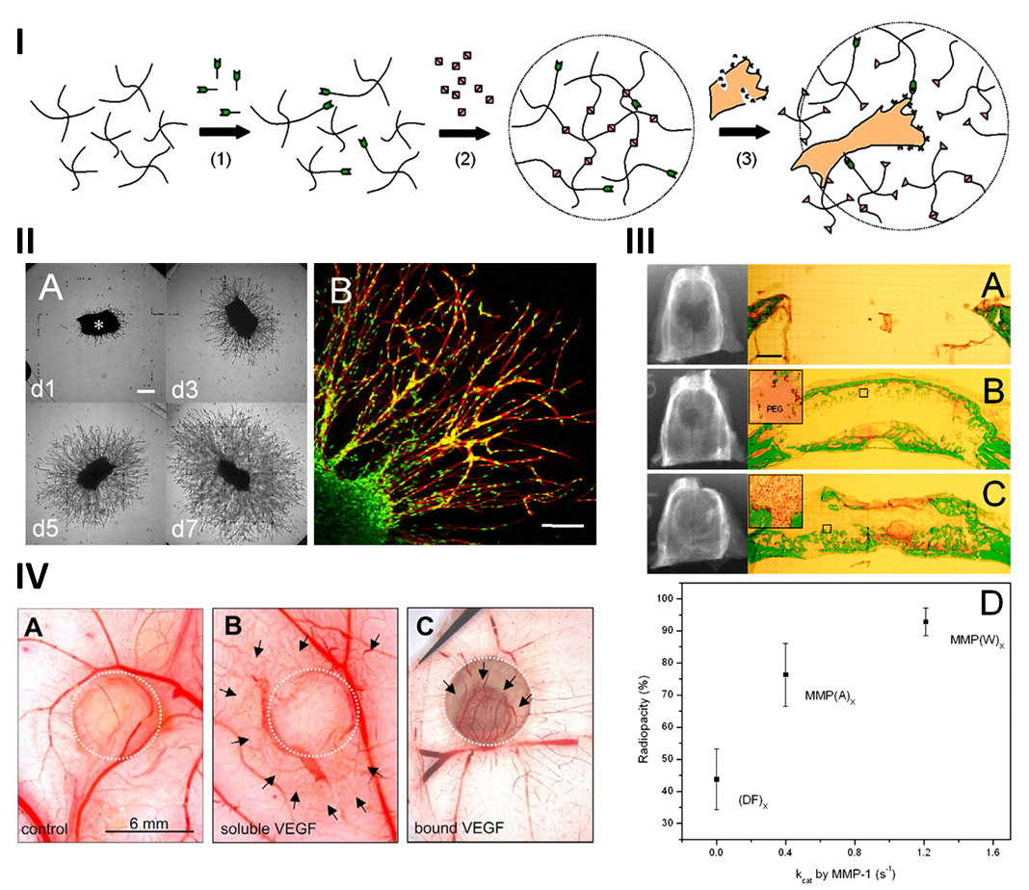
Notes:
Figure 6.9: MMP sensitive synthetic hydrogels enable tissue engineering. I) schematic for the formation of the hydrogel and the invasion/cleavage of the MMP sensitive sites by an invading cell. II) Fibroblasts invade these hydrogels over time (A, scale bar 250 µm) and these fibroblasts invaded as groups of spindles (B, scale bar 150 µm). III) When implanted in vivo MMP degradable hydrogels facilitated the repair of a mouse cranial defect. A non-MMP degradable hydrogel (A), and a moderately (B) and highly degradable hydrogel (C) both showed improved defect repair, as can be seen in the quantification of bone density via radiopacity (D). IV) Incorporation of MMP sensitive PEG hydrogels with a plasmin degradable linker to VEGF allowed controlled vascularization. Seen is the control (A), the soluble VEGF (B), and the enzymatically released VEGF. Increases in vessel density can be seen around the gel in B yet is controlled to the location of the gel within C.
Figure 6.9I/III from Synthetic matrix metalloproteinase-sensitive hydrogels for the conduction of tissue regeneration: engineering cell-invasion characteristics, Lutolf et al., 2003. Copyright 2003 FAESB. Figure 6.9IV form Cell-demanded release of VEGF from synthetic, biointeractive cell ingrowth matrices for vascularized tissue growth, Zisch et al., 2003. Copyright 2003 National Academy of Sciences.

Slide 11
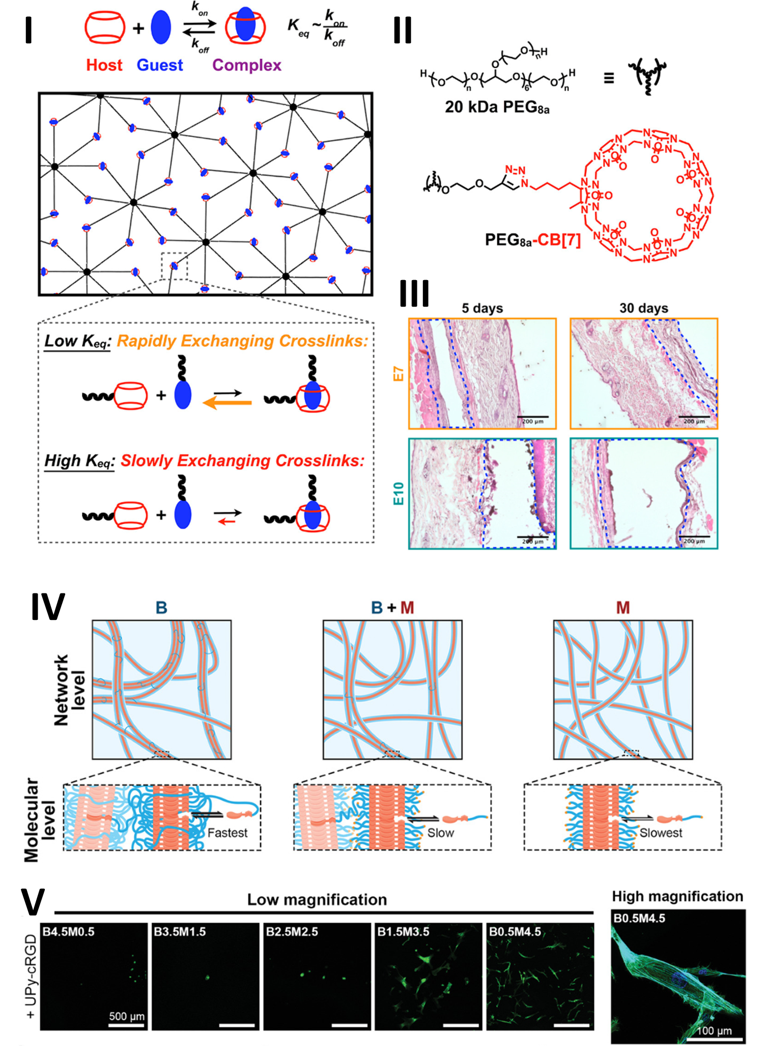
Notes:
Figure 6.10: Dynamics within materials have an impact on their potential for tissue engineering.
Figure 6.10I/III from Dynamic Supramolecular Hydrogels Spanning an Unprecedented Range of Host–Guest Affinity, Zou et al., 2019. Copyright 2019 American Chemical Society. Figure 6.10IV-V adapted from Engineering the Dynamics of Cell Adhesion Cues in Supramolecular Hydrogels for Facile Control over Cell Encapsulation and Behavior, Diba et. al., 2021 under CC BY 4.0.

Slide 12
Notes:
Scheme 6.1: The synthetic scheme for the a) chain-growth polymerization of methyl methacrylate to afford poly(methyl methacrylate) (PMMA), b) step-growth polymerization of bifunctional glycolic acid to afford poly(glycolic acid) (PGA).

Slide 13
Notes:
Scheme 6.2: The synthetic scheme for the a) modification of the synthetic poly(vinyl acetate) to poly(vinyl alcohol), b) modification of the naturally occurring alginate to oxidized alginate. The biomaterials obtained post-modification exhibit different physico-chemical and biological properties compared to their respective precursor biomaterials and can therefore be used in a different set of biomedical applications.

Slide 14
Notes:
Scheme 6.3: The synthetic scheme for the surface modification of a polymer with an RGD peptide. The carboxylic acid functional groups (-COOH) on the surface of a polymer (for example alginate, hyaluronic acid or poly(caprolactone)) undergo a coupling reaction with the RGD peptide to improve cell-material interactions.

